Slide 1
CLTV Predictive Segmentation for personalized insurance policies
Course ID: CSE 572
Group: 21
Members:
Shreyas Hingmire
Nayan Bhiwapurkar
Sudeeksha Vandrangi
Vaishnavi Chunchu
Toshal Warke
Notes:
Hi everyone,
It gives us great pleasure to welcome you to our project presentation for the CSE 572 course. We chose to explore a dataset that holds the intricate details of customer interactions and policy dynamics and forecast the Customer Lifetime Value (CLTV) and engage in predictive segmentation to tailore personalized insurance policies.

Slide 2
Outline:
Introduction
Background, what, why, intro to dataset
05
Proposed Data Mining Pipeline
.
01
04
Exploratory Data Analysis
Problem Formulation
Kind of task
02
03
Data Challenge
Preprocessing
Notes:
Moving forward, this is the outline of our presentation.

Slide 3
Introduction:
Background: Vahan Bima, a leading Indian motor vehicle insurance company, seeks to enhance customer experience through personalized programs.
What: The project involves building a machine learning model to predict Customer Lifetime Value (CLTV) based on user and policy data, and segment customers into different segments
Why it matters: By using CLTV and segmenting customers, the company aims to strategically personalize services, improving customer satisfaction and loyalty.
Notes:
A little background regarding the project. Vahan Bima is a prominent motor vehicle insurance company and they wish to forecast the CLTV based on the user and policy data. They further seek to segment the customers based on the data to improve their satisfaction and loyalty through personalized programs.

Slide 4
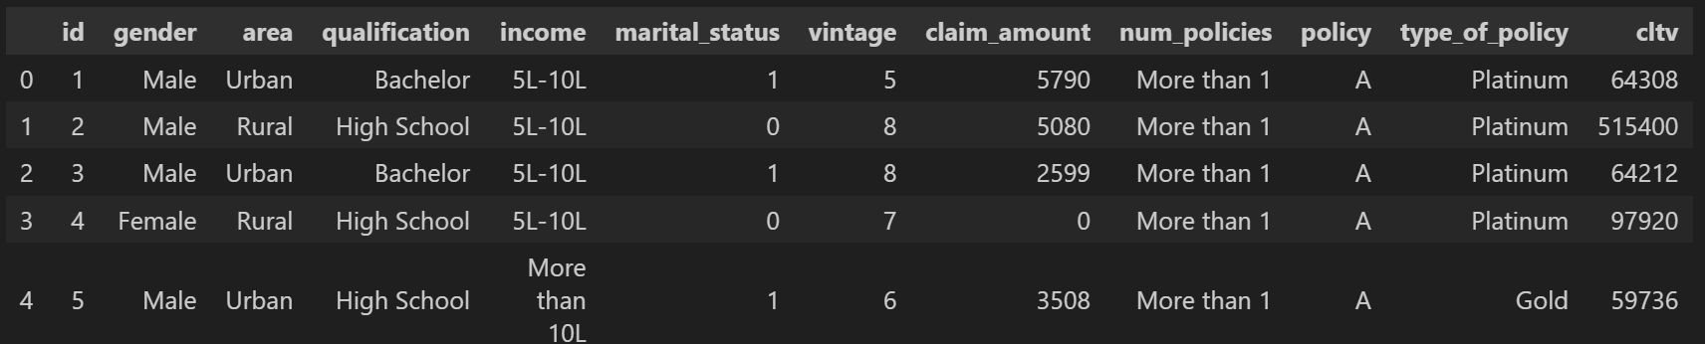
Problem Formulation
Dataset Overview: The dataset consists of detailed information about customers and their engagement with different customer policies.
Goal: To predict the CLTV metric, based on customer and policy features; Regression task
Segment the customers for enhanced personalized policies; Clustering task
Notes:
Moving forward, let's now take a look at the dataset:
The VahanBima dataset provides a comprehensive snapshot of customer and policy information, serving as a valuable resource for predictive modeling. Key features include unique customer identifiers (id), gender, area, highest qualification, annual income, marital status, vintage (years since the first policy), total claimed amount (claim_amount), the number of policies issued (num_policies), details of the active policy, type of policy, and the target variable - Customer Lifetime Value (CLTV).
This dataset is particularly well-suited for regression tasks aiming to predict CLTV, allowing the development of models that can forecast the long-term value of customers. The diverse set of features, ranging from demographic information to policy details, offers the potential to uncover complex relationships and patterns that influence customer lifetime value.
Additionally, the dataset could be used for clustering tasks to segment customers based on shared characteristics, aiding VahanBima in tailoring personalized experiences and optimizing customer engagement strategies.
However, potential challenges include handling outliers, addressing multicollinearity, and ensuring appropriate preprocessing for effective model development. Overall, the VahanBima dataset provides a rich foundation for data mining tasks aimed at enhancing customer experience and strategic decision-making within the insurance company.

Slide 5
Data Challenges
Data can not be directly fed into ML model.
Dataset has categorical columns
Outliers affect data quality
Numerical columns have varied ranges
Some irrelevant features exist
To solve this problem, we will use Data Pre-Processing steps.

Slide 6
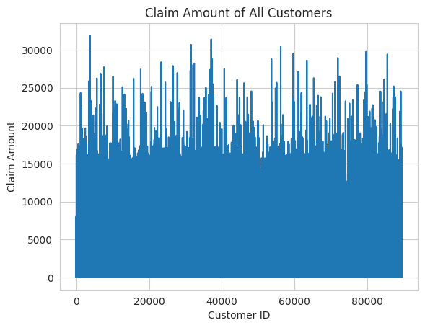
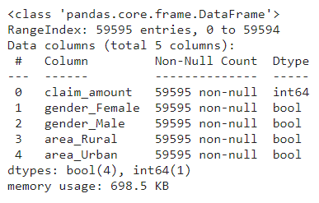
Data Preprocessing
Encoding
(Nominal, Ordinal)
Discretization

Slide 7
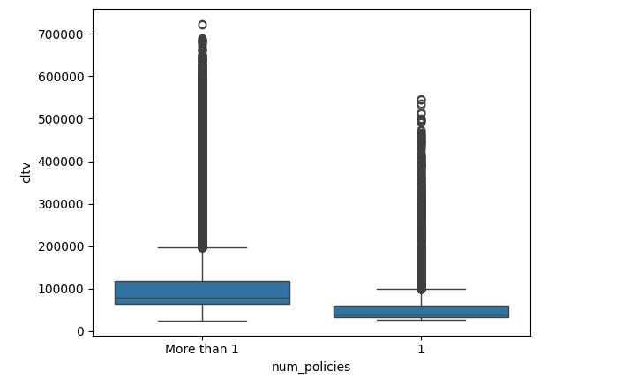
Data Preprocessing
Handling Outliers

Slide 8
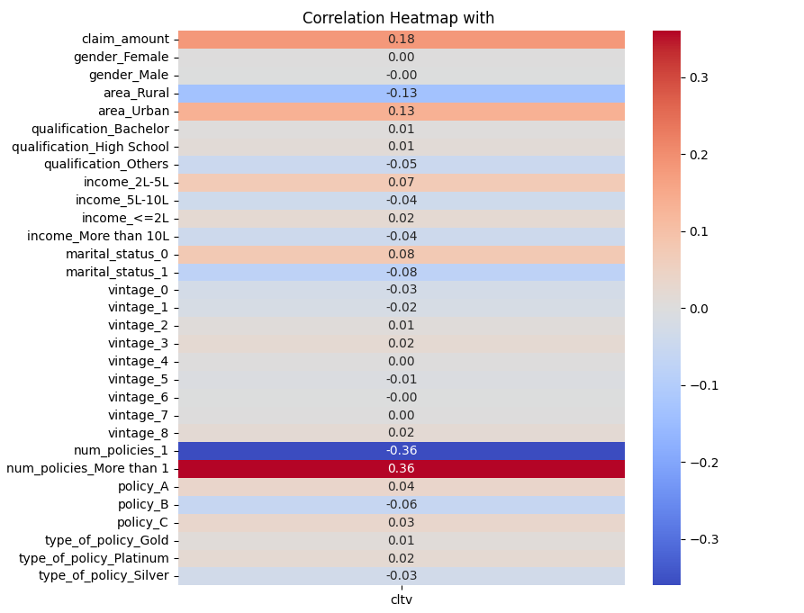
Feature Engineering

Slide 9
Model challenge
Finding optimal ML model for regression
Finding suitable number of clusters for customer segmentation
Overfitting

Slide 10
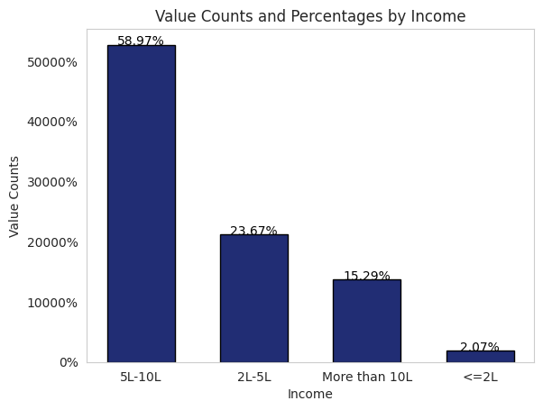
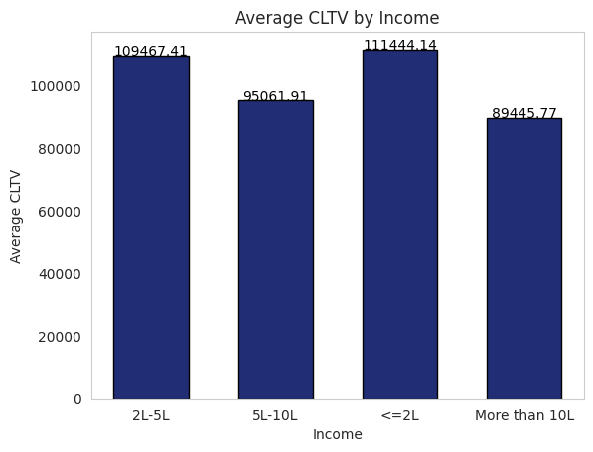
EDA - Based on Income

Slide 11
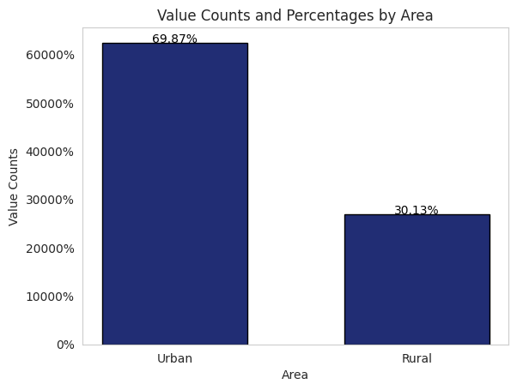
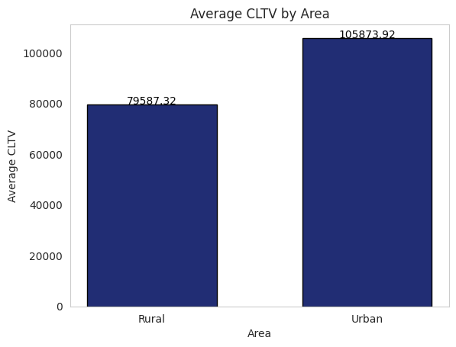
EDA - Based on Area

Slide 12
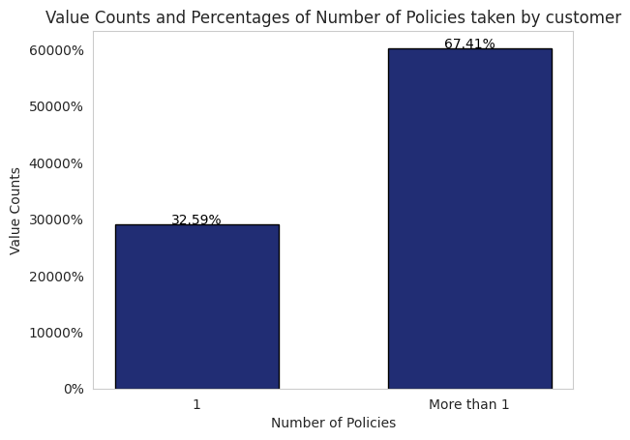
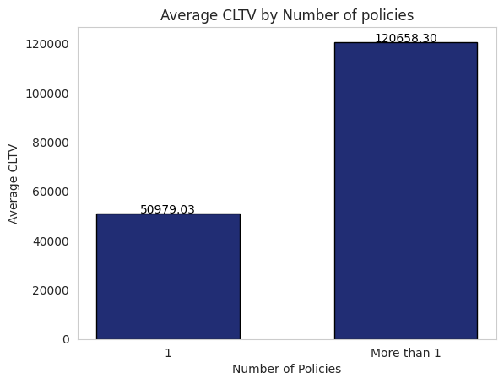
EDA - Based on Num_of_Policies

Slide 13
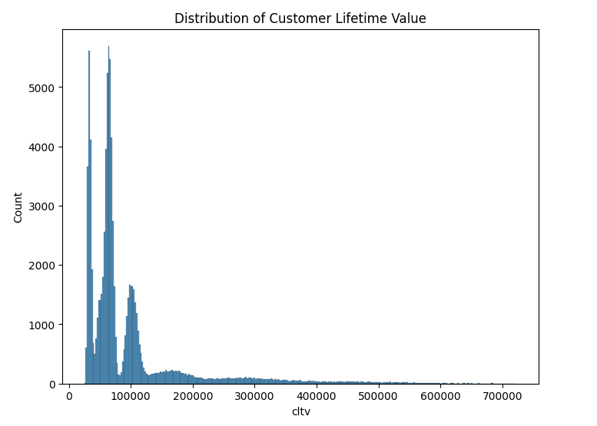
Distribution of cltv ( target variable)

Slide 14
Data Mining System Pipeline
Data Collection
Data Pre-Processing
Encoding, Handling outliers
Discretization, Feature Engineering
EDA
Exploratory Data Analysis
Model Selection
Selecting ML model based on validation dataset accuracies
Train
different
ML models
on Training Dataset
Data Splitting
(Train, Test, Validation)
Calculate Accuracy
of Model
on Test Dataset
Improve Accuracy
(Hyper-parameters, K-Fold)
Clustering Customers

